Slide 1
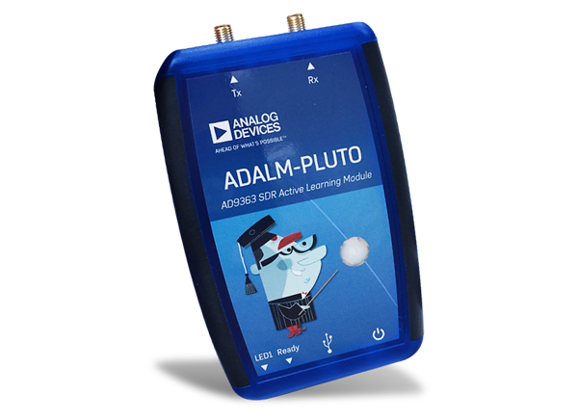
Final project
WiFi Spectrum Analyzer
Team
Tsourdinis Theodoros
Chatzistefanidis Ilias

Slide 2
Project’s purpose
Computing WiFi Channel’s Traffic
Finding Optimal Channel
Extracting Pattern from Channel’s Occupation
Predicting Future Behavior

Slide 3
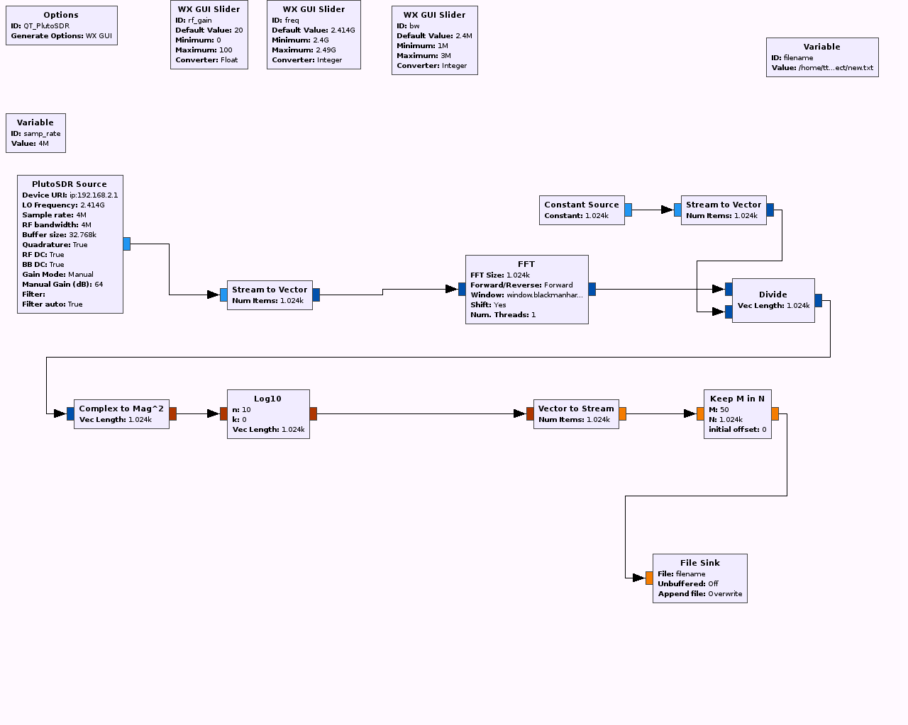
GNU radio flowchart

Slide 4
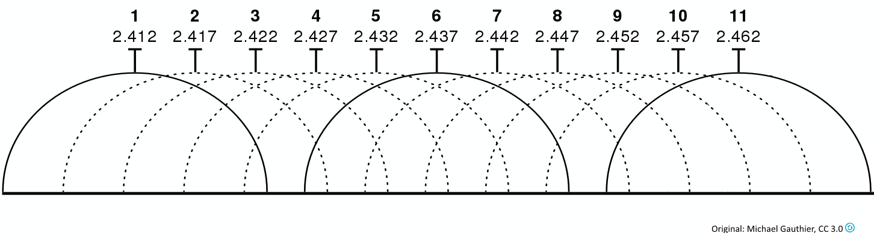
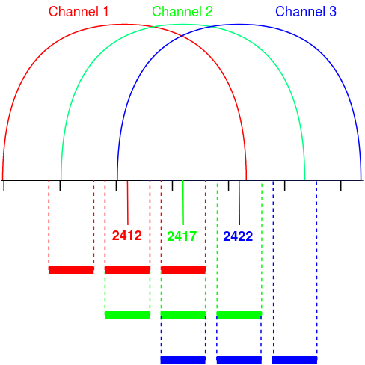
Measurement Technique
WiFi 2.4 GHz Spectrum
2.4GHz Band: 22MHz Channels with Overlapping
Measurements for 12 out of 22 MHz
measurements with 4 MHz bandwidth
for center frequencies that have distance 5 MHz from each other
Our Technique
Finally:
13 Measurements
11 Channels

Slide 5
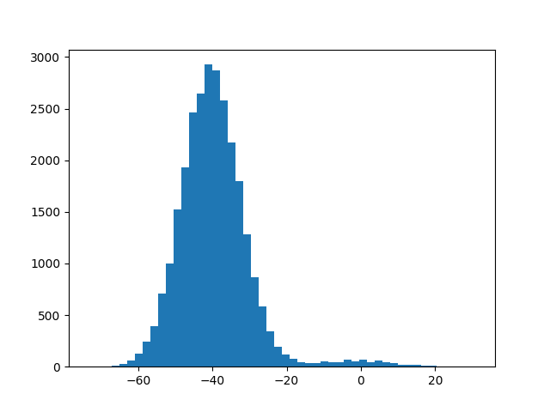
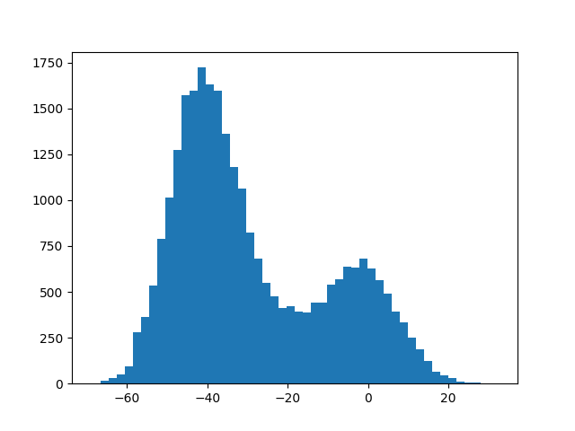
Transmission indicator
Busy Percentage = 3%
Energy Values are floats with range [-60 , +20] dB
Threshold = - 20dB
Busy_Percentage =
(# values > -20 )/( # all_values)
dB
Busy Percentage = 30%
dB

Slide 6
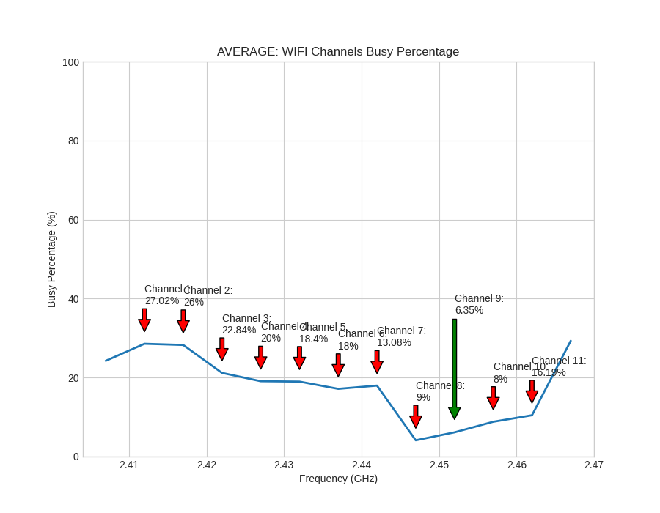
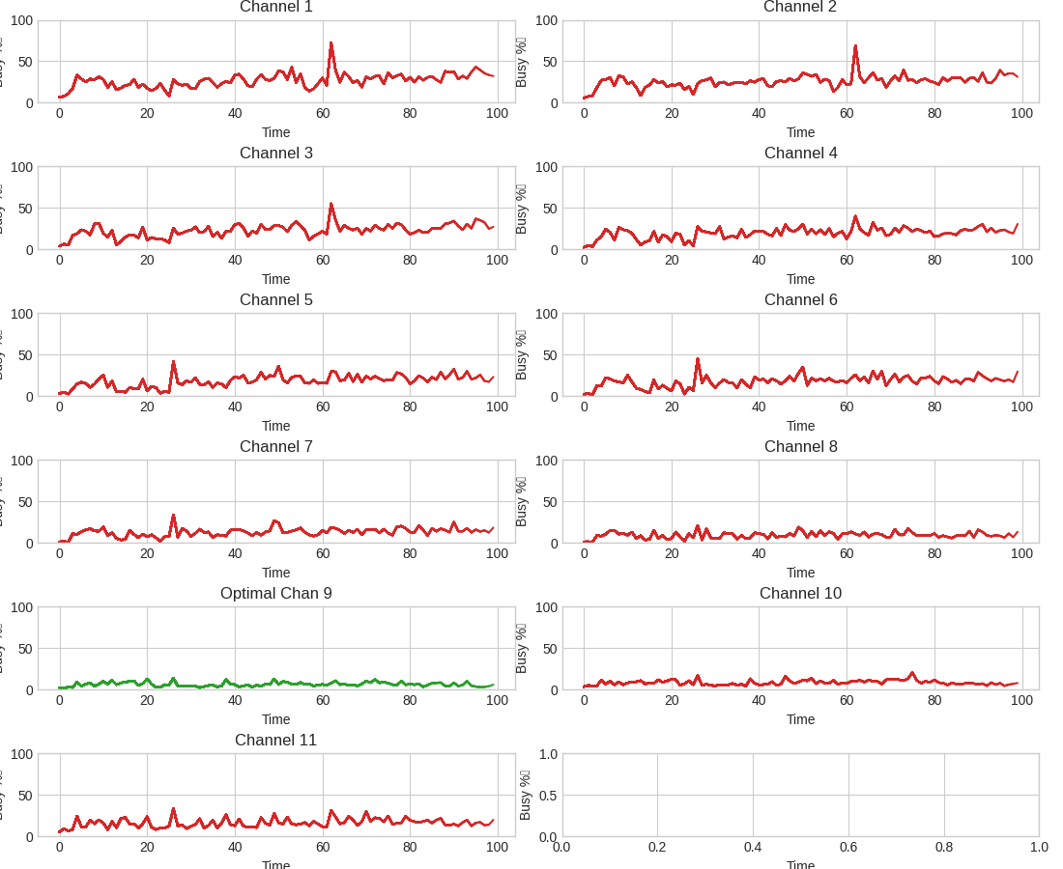
OUR ALGORITHM – PYTHON scripts
For T iterations:
spectrum measurements → binary files
convertion to decimal
calculation of Busy_Percentage
create 3 real-time plots:
i) Current Plot
ii) Average Plot
iii) Time plot
Busy_Percentage → output.txt

Slide 7
RESULTS – 2.5 Hours

Slide 8
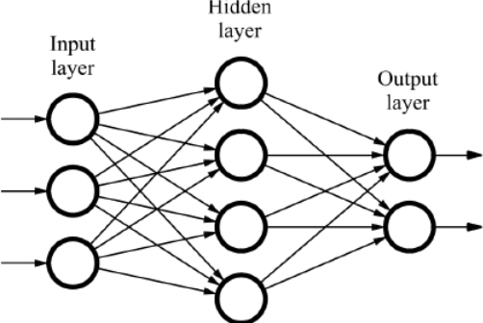
FUTURE FORECASTING
Time Series Forecasting
Long short-term memory (LSTM) Recurrent Neural Networks.
Split Data to :
First 2.0 hours (80 iterations) for Training
Last 0.5 hours (20 iterations) for Testing
Prepare Data for model ( 3D Input )

Slide 9
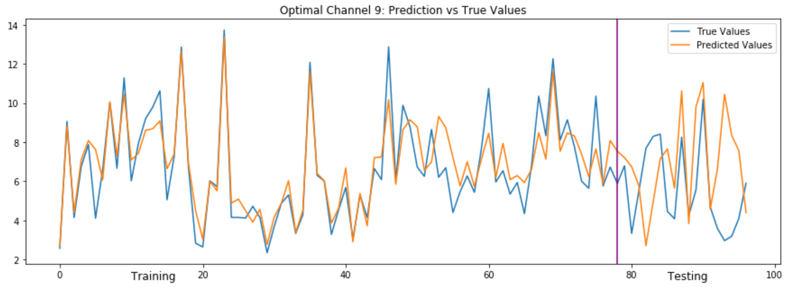
PREDICTIONS
Optimal - Channel 9
Predicted Busy_Percentage = 6.98 %
Real Busy_Percentage = 5.63 %

Slide 10
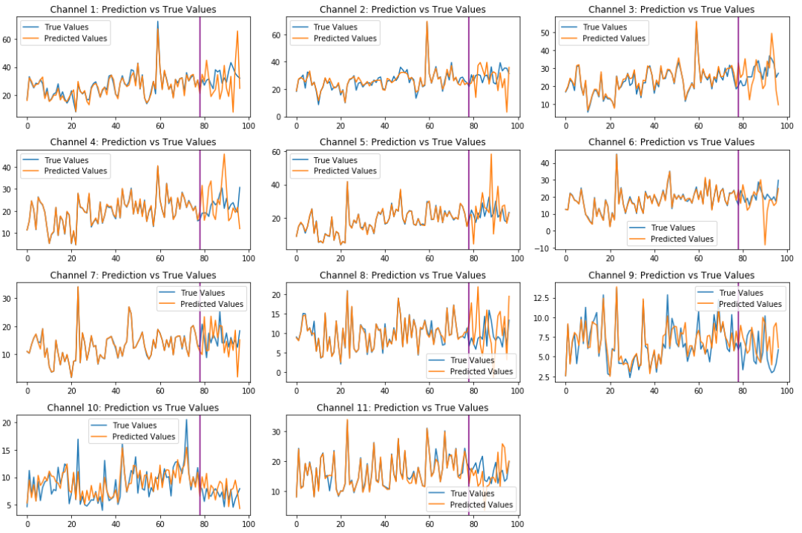
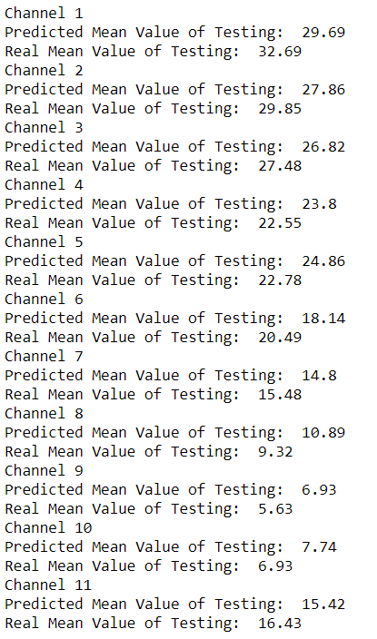
PREDICTIONS

Slide 11
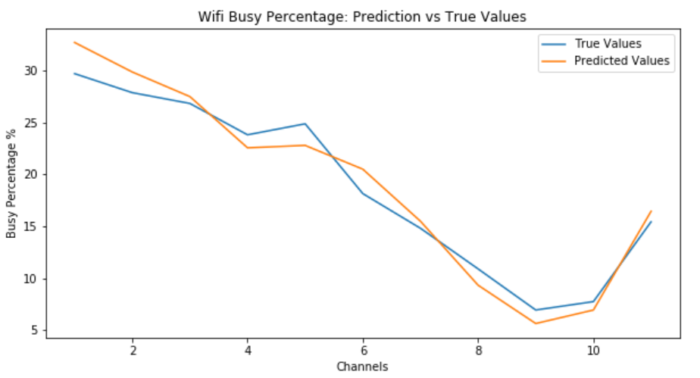
PREDICTIONS
For last 0.5 / 2.5 hours:
Predicted Optimal : Channel 9
Measured Optimal : Channel 9

Slide 12
THANK YOU FOR YOUR ATTENTION!

